Slide 1




Swish – Real Time Chat
Group Members:
Biswajeet Panda – 21CSE532
Jagannath Patro – 21CSE570
Rishav Kumar – 21CSE506
Guided By: Mr. VSK Chaitanya

Slide 2


Content
Abstract
Introduction
Objective
Motivation
Methodology
Implementation
Conclusion
References

Slide 3

Abstract
Swish - Real-Time Chat is a messaging application built with the MERN stack, ensuring seamless and efficient communication. It uses WebSockets for instant message updates, providing a smooth user experience. Designed for scalability and performance, it offers a reliable real-time chat environment. With a user-friendly interface and responsive design, Swish delivers a fast, secure, and engaging messaging experience using modern web technologies.
Real-time chat bridges the gap between expectation and instant communication.

Slide 4

Introduction
Swish ⏩
In today's digital era, real-time communication is crucial for efficient interaction. Messaging applications like Swish enable instant and seamless exchanges, improving collaboration and user engagement. They eliminate delays, enhance accessibility, and provide a more interactive experience. With a focus on speed, security, and scalability, Swish ensures reliable and effective communication, making it an essential tool for modern connectivity.

Slide 5

Objective
The objective of Swish – Real Time Chat is to develop a seamless and efficient messaging platform using the MERN stack. It aims to provide instant communication through real-time message updates using WebSockets. The project focuses on scalability, reliability, and a user-friendly interface to enhance the messaging experience. By ensuring secure and fast interactions, Swish aims to deliver a modern, responsive, and interactive chat environment that meets the growing demand for real-time digital communication.

Slide 6

Motivation
The motivation for this project is driven by the following objectives:
Enable seamless and instant real-time communication.
Improve user experience with a responsive and interactive interface.
Utilize modern web technologies for secure and fast performance.
Ensure scalability and reliability for efficient messaging.

Slide 7
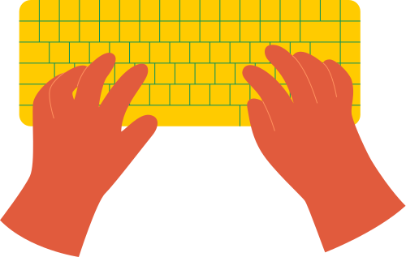
Methodology
Frontend Development: React.js, Tailwind CSS, Zustand and DaisyUI,
Backend Development: Node.js, Express.js, Socket.io
Database Management: MongoDB
Cloud: Cloudinary (for media management)

Slide 8


Implementation
Swish ⏩
Swish’s frontend is built using React, styled with Tailwind CSS and DaisyUI, and managed with Zustand for a seamless real-time experience.
The backend uses Node.js, Express.js, and Socket.io to handle APIs, authentication, and WebSockets for instant, real-time message communication.
MongoDB stores user data and chat history efficiently, ensuring fast retrieval with optimized schema design, indexing, and structured data management.
Cloudinary is used for storing and managing media files, ensuring efficient image optimization, secure uploads, and fast delivery within chats.

Slide 9
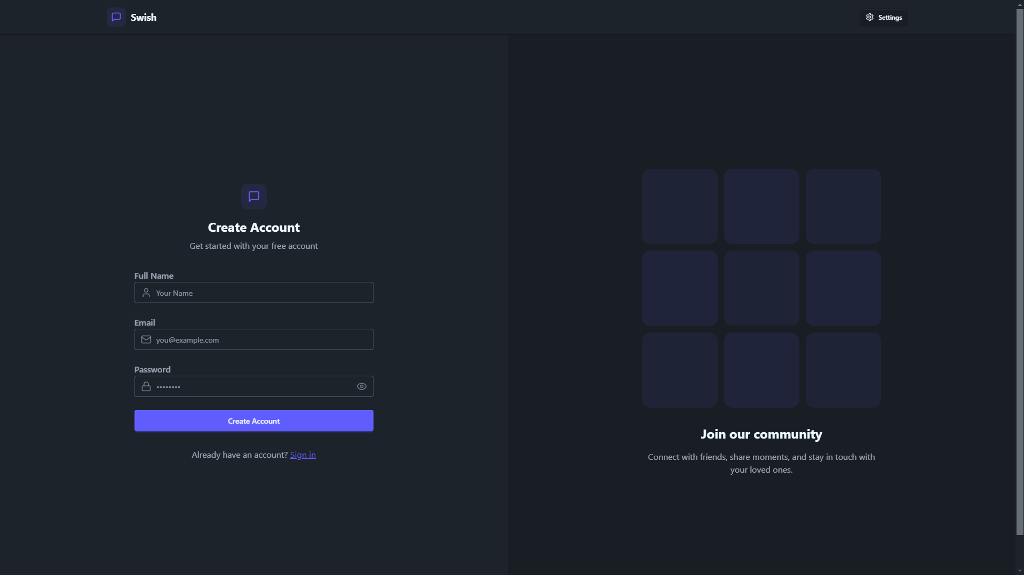
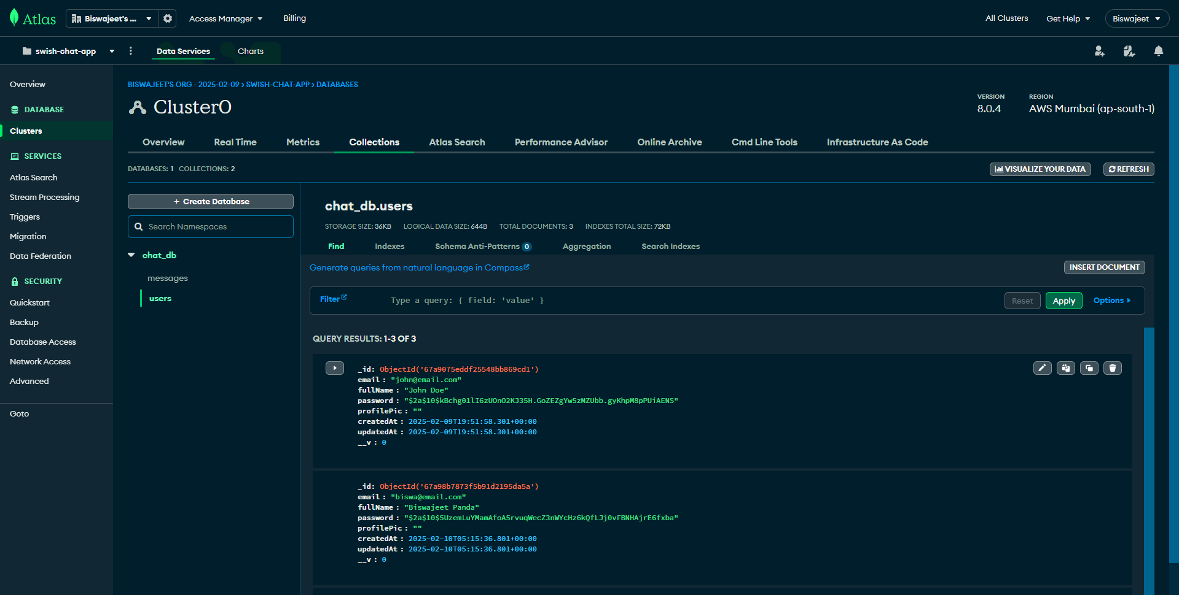
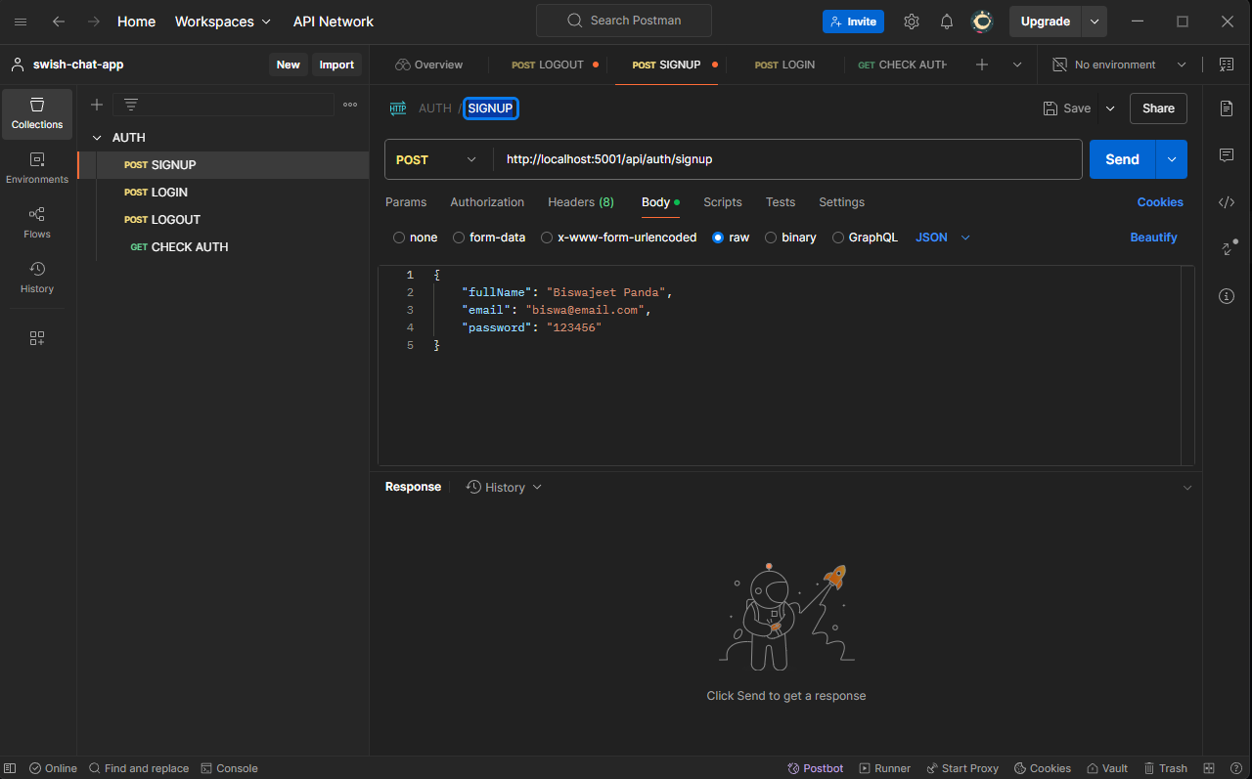

Slide 10
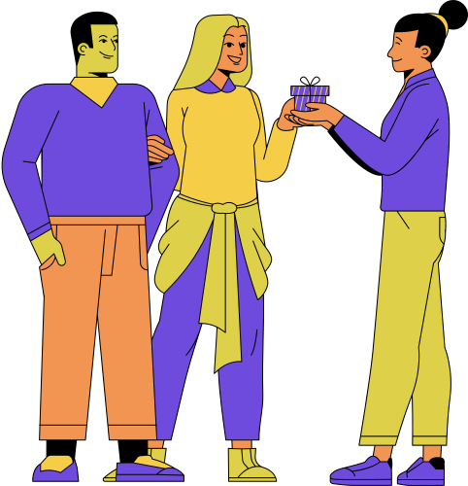
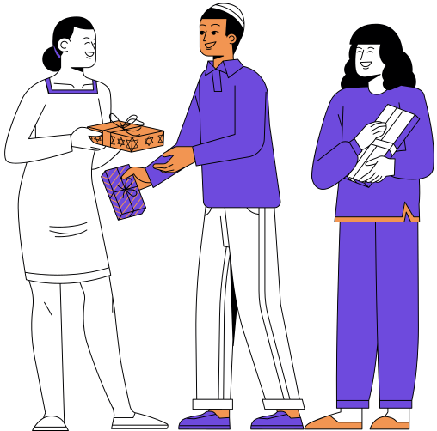
Conclusion
Swish – Real Time Chat provides a seamless, real-time messaging experience using the MERN stack. With an optimized frontend, efficient backend, and scalable database, it ensures instant communication. Secure authentication, media management with Cloudinary, and responsive design enhance usability. Swish delivers a reliable, fast, and engaging chat platform for modern communication.
Hey! How are you?
I am doing good. What about you?

Slide 11


References
Socket.io Chat Application Guide – https://socket.io/get-started/chat
WebSockets Overview: https://developer.mozilla.org/en-US/docs/Web/API/WebSockets_API
JWT Authentication: https://jwt.io/introduction/

Slide 12

How do we interact with texts?
Reading
Creating
Responding

Slide 13
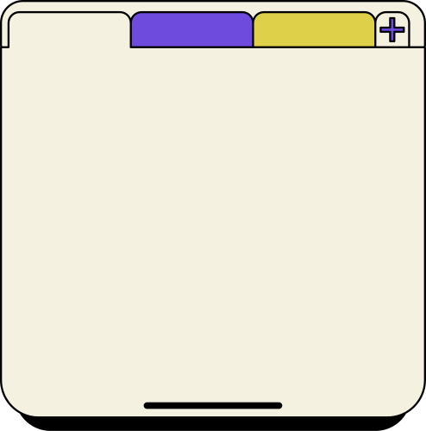



Reading
With technology, e-books, audiobooks, and online reading platforms have increased in popularity.
Think about the traditional way of reading as opposed to reading on a digital device. What are some differences between the two?

Slide 14


Creating
Technology enables the creation and sharing of different narratives through digital platforms, and enhances them with multimedia elements.
Digital tools often streamline the creative process, offering features like spell-check, formatting and easy editing.

Slide 15

Effects of Technology on Creating
Sample Answers
Cause: Modern technology facilitates open discussions about hobbies, experiences, news, and even products within online communities.
Effect: These platforms connect individuals worldwide, promoting dialogue and a sense of unity.

Slide 16


Responding
What was your last comment online? The immediacy of online communication enables quick responses through comments, likes, shares, and reactions on social media platforms.

Slide 17
Resource Page
Use these images in your Canva Presentation. You can also use the code for searching for more images tab. Happy designing! Don't forget to delete this page before presenting.
set:nAFnjlyyggg

Slide 18


Try this background for online class.
*Please delete this section before downloading.

Slide 19
Press these keys
while on Present mode!
B
for blur
C
for confetti
D
for a drumroll
M
for mic drop
O
for bubbles
Q
for quiet
U
for unveil
Any number from 0-9 for a timer

